Slide 1
Introduction to Bootstrap and Grid system

Slide 2
Objectives
Identify the purpose of using front-end UI frameworks in web design and development
Set up a project with Bootstrap support
Configure a web project to use Bootstrap
Become familiar with the basic features of Bootstrap
Understand the reasons for using responsive web design in a web project
Use the Bootstrap grid system to design responsive websites
Add your own custom CSS classes to a Bootstrap based web project

Slide 3
Front-End Web UI Frameworks

Slide 4
What are front-end UI frameworks?
Collection of ready-to-use HTML, CSS and JavaScript templates for UI components:
Typography, Forms, Buttons, Tables, Navigations, Dropdowns, Alerts, Modals, Tabs, Accordion, Carousel etc.

Slide 5
Popular front-end UI frameworks
Bootstrap
Semantic-UI
Foundation
Materialize
Material UI
Pure
Skeleton
UIKit
Milligram
Susy
https://www.keycdn.com/blog/front-end-frameworks/

Slide 6
Why Front-End Web UI Frameworks?
Responsive web design
Mobile first
Cross-browser compatibility
Dealing with quirks of browsers
Increased productivity
Easy to get started
Community support
Resources and web page templates

Slide 7
Introduction to Bootstrap

Slide 8
Bootstrap Overview
Bootstrap is the most popular HTML, CSS, and JS framework for developing responsive, mobile first projects on the web
From the Bootstrap webpage
Front-end framework for faster and easier web development
Includes HTML and CSS based design templates for typography, forms, buttons, tables, navigation, modals, image carousels and many other, as well as optional JavaScript plugins
Easily create responsive designs with mobile first approach

Slide 9
Bootstrap History
First released in 2011
Mark Otto and Jacob Thornton
Current Production Version 5.0
This course covers 4.6.0, but most classes still applicable to 3.3.7
The first comprehensive framework
Gained popularity very quickly

Slide 10
Exercise 5: Getting Started with Bootstrap

Slide 11
Bootstrap Grid System

Slide 12
Viewport
<meta name="viewport" content="width=device-width, initial-scale=1, shrink-to-fit=no">
The viewport meta tag:
Ensures that the screen width is set to the device width and the content is rendered with this width in mind
Designing the websites to be responsive to the size of the viewport
Bootstrap grid system
http://getbootstrap.com/docs/4.0/layout/grid/

Slide 13
Bootstrap Grid
Designed to be:
Responsive
Mobile first
Fluid

Slide 14
CSS Flexbox Layout
Simpler and flexible layout options in CSS
Can easily handle dynamic/unknown size of content containers
Direction-agnostic layout

Slide 15
Why Flexbox for Bootstrap?
Easy vertical alignment of content within a parent element
Easy reordering of content across devices and screen resolutions with the help of media queries
Easy CSS-only equal height columns for your grid-based layouts

Slide 16
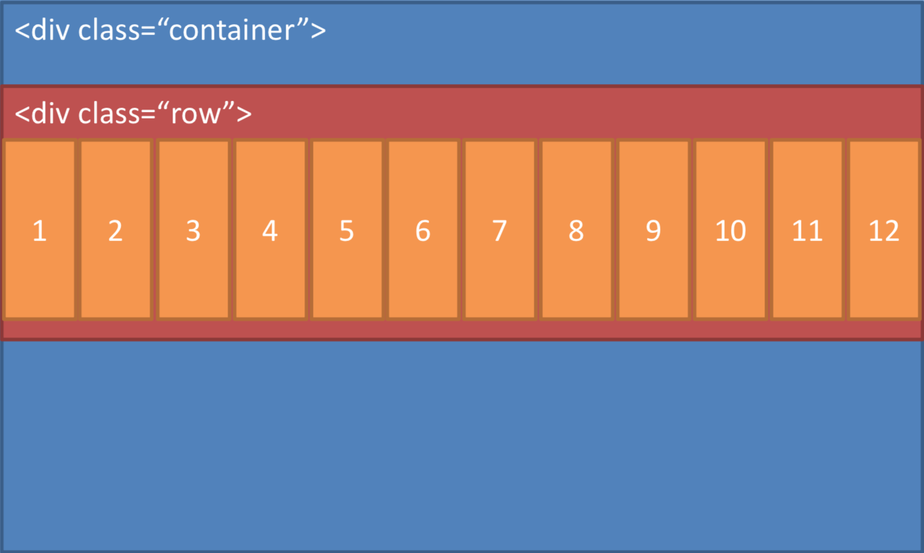
Bootstrap Grid

Slide 17
Bootstrap Grid
Bootstrap makes available five classes
default targets all screen sizes from extra small to extra large,
sm for small,
md for medium,
lg for large, and
xl for extra large screen sizes
Each row in Bootstrap grid system is divided into 12 columns
Use the classes .col-*, .col-sm-*, col-md-*, and .col-lg-* for defining the layouts for the various screen sizes
Specify how many columns each piece of content will occupy within a row, all adding up to 12 or a multiple thereof

Slide 18
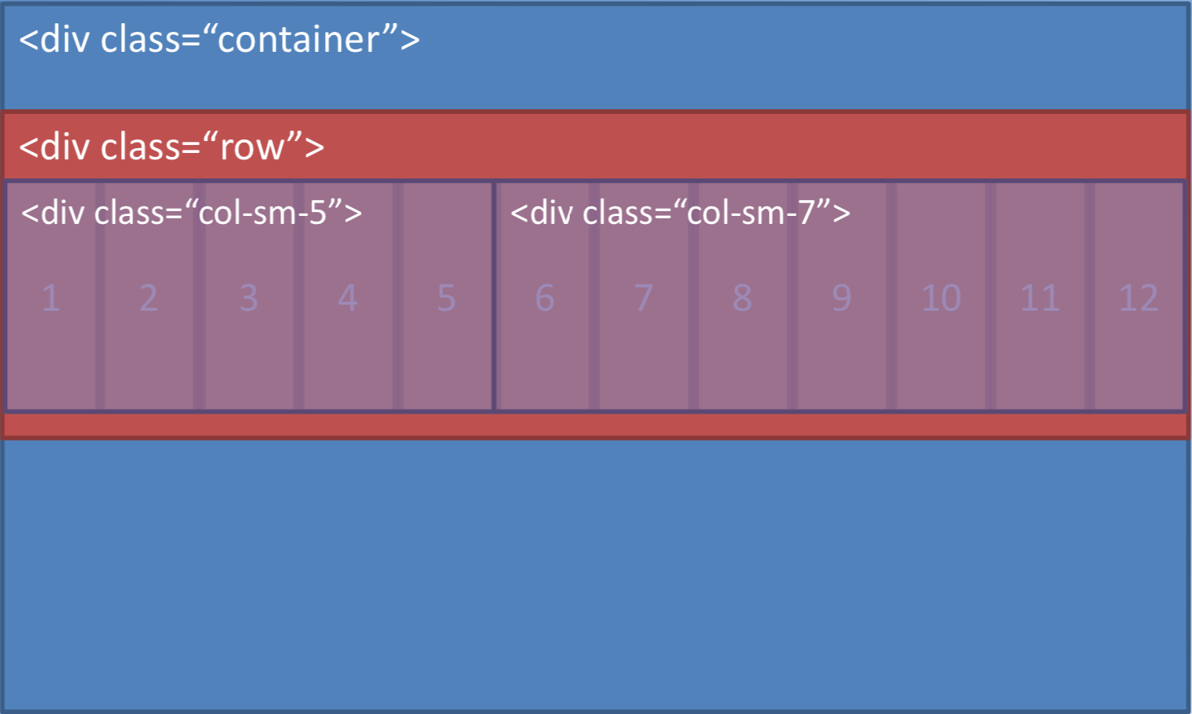
Bootstrap Grid

Slide 19
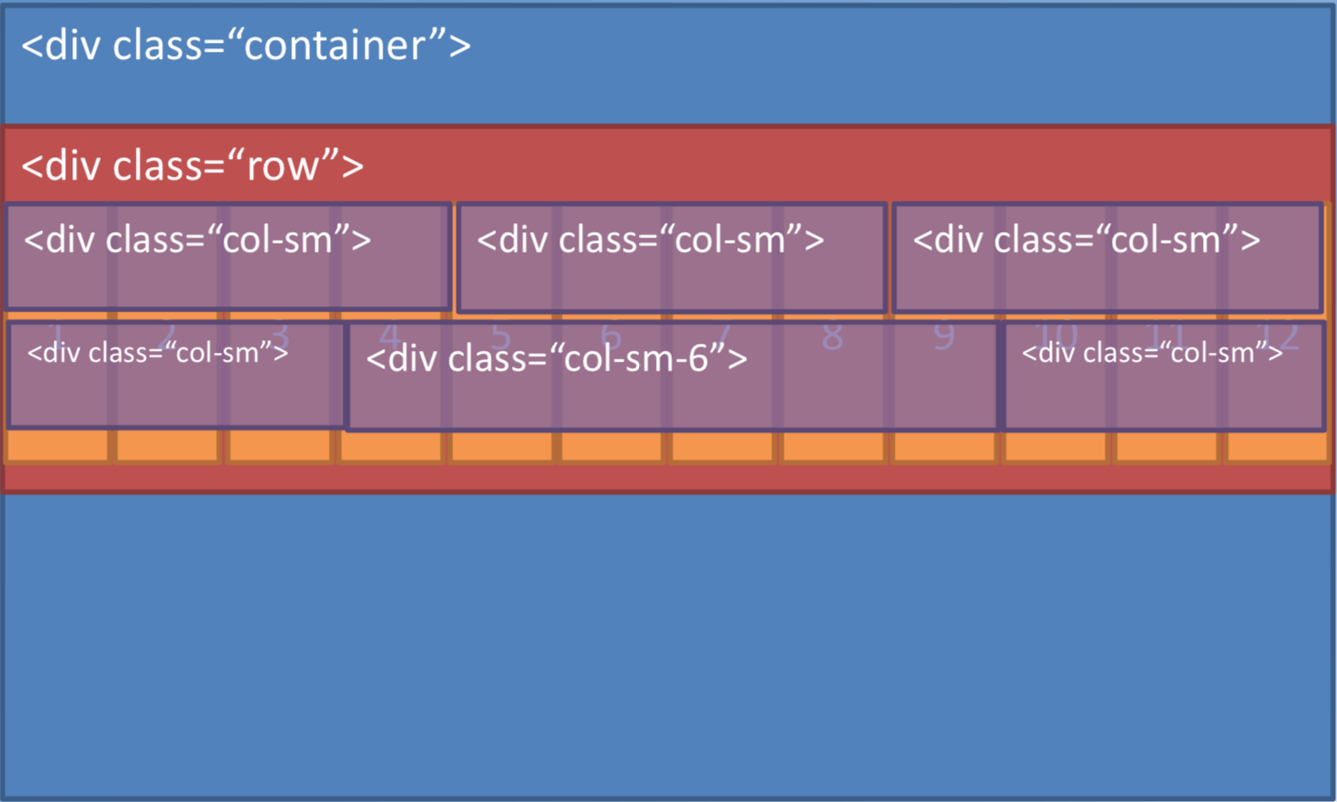
Auto-layout Columns

Slide 20
Bootstrap Grid Details
 | Extra small <576px | Small ≥576px | Medium ≥768px | Large ≥992px | Extra large ≥1200px
Grid behavior | Horizontal at all times | Collapsed to start, horizontal above breakpoints
Max container width | None (auto) | 540px | 720px | 960px | 1140px
Class prefix | .col- | .col-sm- | .col-md- | .col-lg- | .col-xl-
# of columns | 12
Gutter width | 30px (15px on each side of a column)
Nestable | Yes
Offsets | Yes

Slide 21
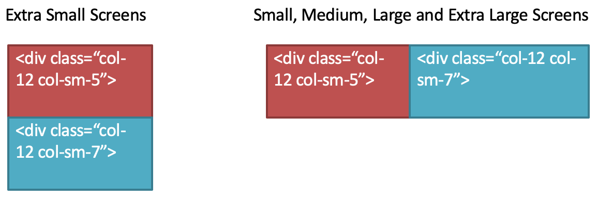
Using Column classes

Slide 22
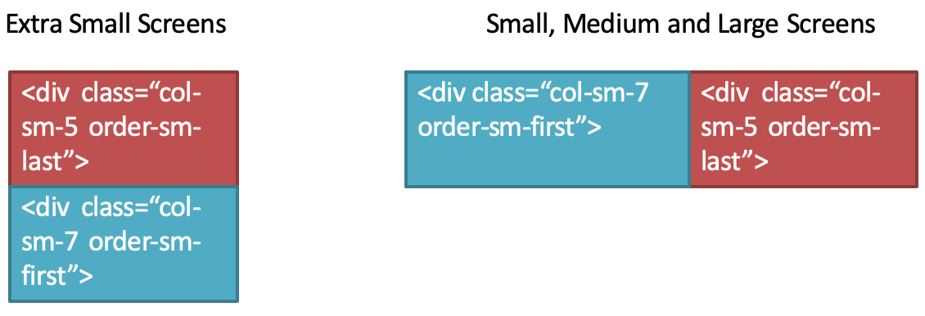
Reordering Content

Slide 23
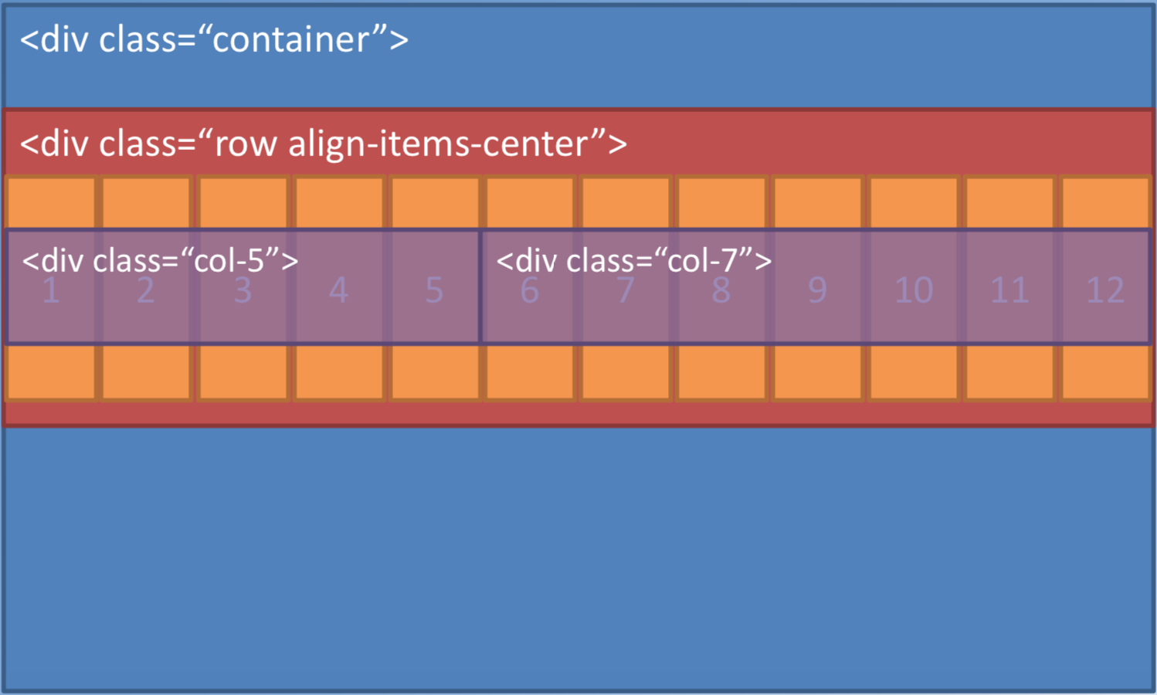
Vertical Alignment

Slide 24
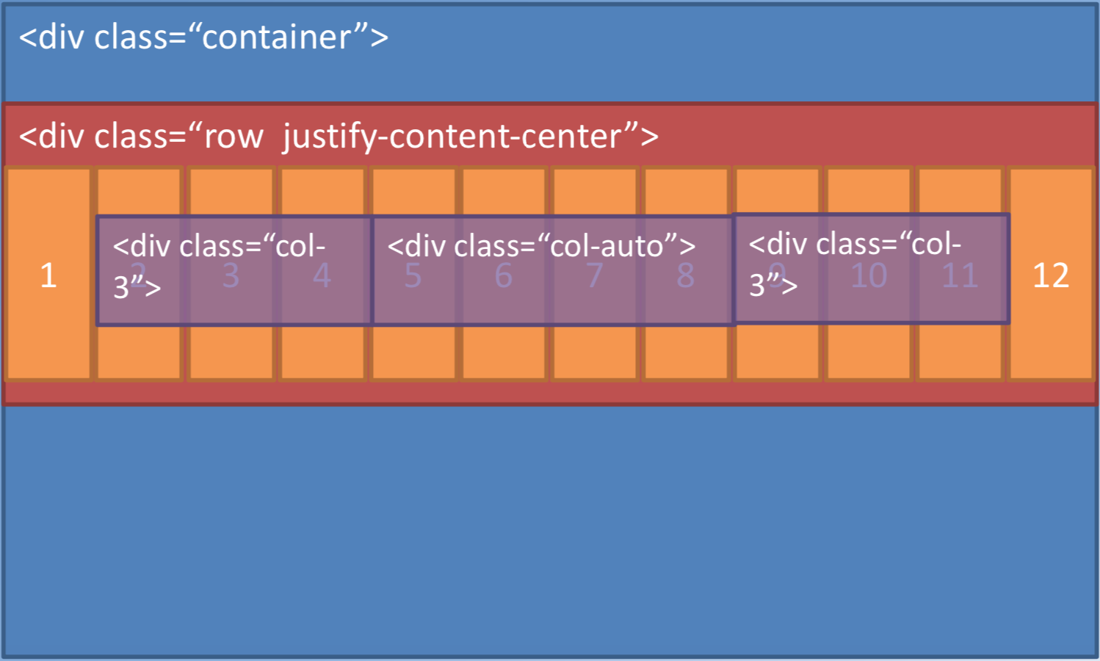
Horizontal Alignment

Slide 25
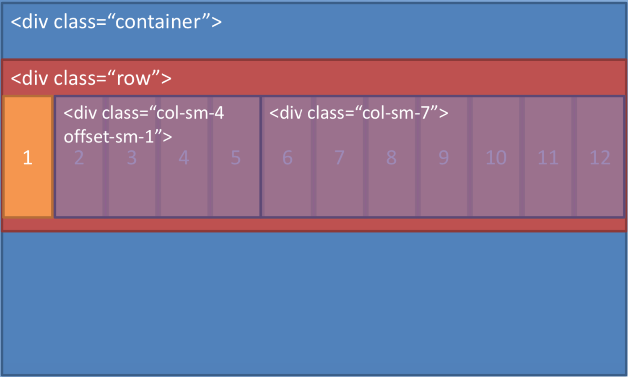
Column Offsets

Slide 26
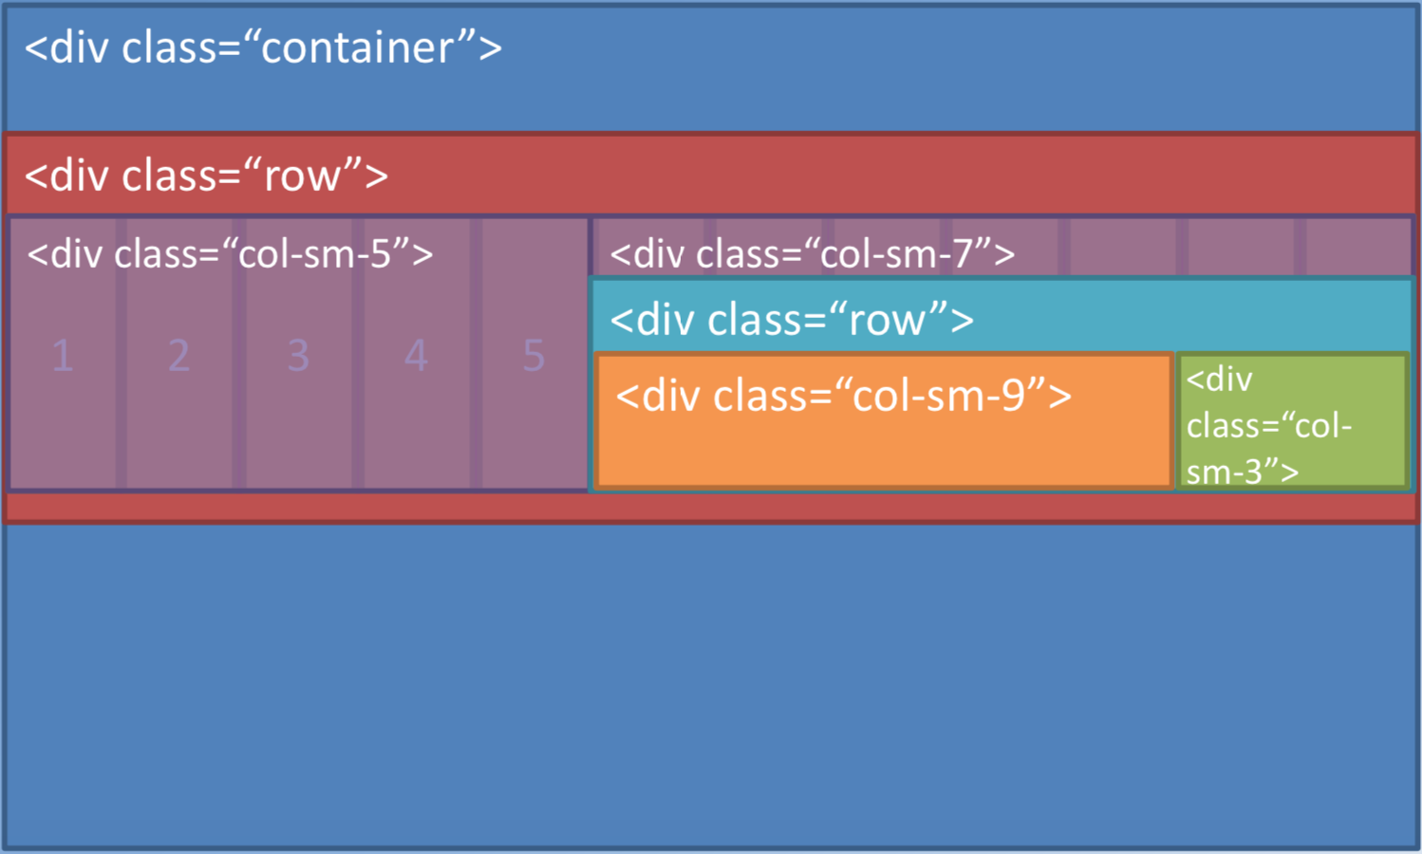
Nesting Columns

Slide 27
Exercise 6: Responsive Design and Bootstrap Grid System
Create responsive websites using the Bootstrap grid system
Customize the CSS classes through your own additions in a separate CSS file

Slide 28
Summary
Understand front-end UI frameworks in web design and development
Set up a project with Bootstrap support
Configure a web project to use Bootstrap
Understand the reasons for using responsive web design in a web project
Use the Bootstrap grid system to design responsive websites
Add your own custom CSS classes to a Bootstrap based web project

